Slide 1
Service synergy: Examining the Cumulative Effects of Community School Services
Sebastian Castrechini
John W. Gardner Center For Youth and Their Communities
Stanford University
AERA Annual Meeting
April 9, 2011

Slide 2
Background
Partnership formed with the district and city collaborative in 2007
School district and city collaborative wanted to assess service provision and effects of the community schools and use data to improve service provision
Wanted to use the Youth Data Archive to link participation and student outcomes
Notes:
They came to us and were interested in working us because of the past relationship with them
wanted a critical partner and to capitalize on the YDA’s ability to combine already-collected data

Slide 3
District Logic Model
INPUTS | STRATEGIES | DELIVERABLES | SHORT -TERM OUTCOMES | LONG-TERM OUTCOMES
CS Coordinator Family Engagement Specialist Funding/Resources Relevant Partners Leadership Collaboration Structure | Family Engagement -Education -Leadership -Volunteerism Extended Learning Opportunities Mental Health/Social Services Support Social/Emotional Learning Professional Development School /partners collaborative | Supported and connected families Comprehensive learning supports Integrated service delivery (physical, emotional, social) High Quality programs Partner Integration into the school day | Children are ready to learn Students are actively involved in learning and their community Students receive supports according to their needs Families are connected with the schools Families are connected with schools | Students succeed academically Students and families are healthier -socially -physically -emotionally Schools are supportive of youth and families Communities are desirable places to live
adapted from Shah et al (2009)
Notes:
Based on logic model from Shah et al (2009)
Lack of rigorous methodology linked to CS logic model – either whole school descriptive studies or individual program evaluations
CS Director developed this
highlighted pieces are both those included in eval and bc they were what we were able to measure/had data on

Slide 4
Research Questions
How many and which students and families participate in the programs and services that are offered at the community schools?
How do the community school programs, and in what combinations, affect student academic achievement outcomes in the long-term?
What short-term outcomes of program participation lead to long-term academic outcomes?

Slide 5
Study Population
Schools: Four schools—one K-8, two K-5s, one 6-8
Programs: 64 total programs for students and parents across the four schools
Students: 3,000 per year, 1,522 all three years:
87% Latino, 7% White
71% FRPL, 64% English learner
62% K-5, 38% 6-8
Notes:
Programs vary by year
Number of students is the number in a community school all three years

Slide 6
Measures
Student demographics, achievement, and school attendance
School district administrative data
2006-07 to 2009-10
Community school program participation
District and outside provider participation records
2007-08 to 2009-10
Sense of care and practices that promote care
Middle school survey data
2008-09 and 2009-10
Notes:
Talk about the standardized scores for achievement – CST (starting in second grade) and CELDT (starting in K) converted to z-scores
Talk about individual growth model methodology – form of HLM that shows the effect of individual level predictors on growth over time and allow us to see how participation affects both baseline outcomes as well as annual improvement.
Make link to Karen’s study in the last part

Slide 7
Program Categories
Family Engagement
Extended Learning
Support
Parent Leadership
Parent Education
Parent Volunteers
After School
Youth Leadership
Counseling
Family Assistance
School Site Council
PTO/PTA
Coaching
ESL Classes
Computer Classes
Outreach
Dialogues
Volunteer Activities
After School Programs
Intercession Programs
Conflict Managers
Legal Education
Individual Counseling
Group Counseling
Case Management
Bus Passes
Uniform Help
Holiday Gift Cards
Notes:
Make different colors for each row
Take more time expalining the parent programs and giving examples -

Slide 8
Key Findings: Participation Over Time
Notes:
Differences between participants and non-participants in terms of SES
Large amount of overlap between categories

Slide 9
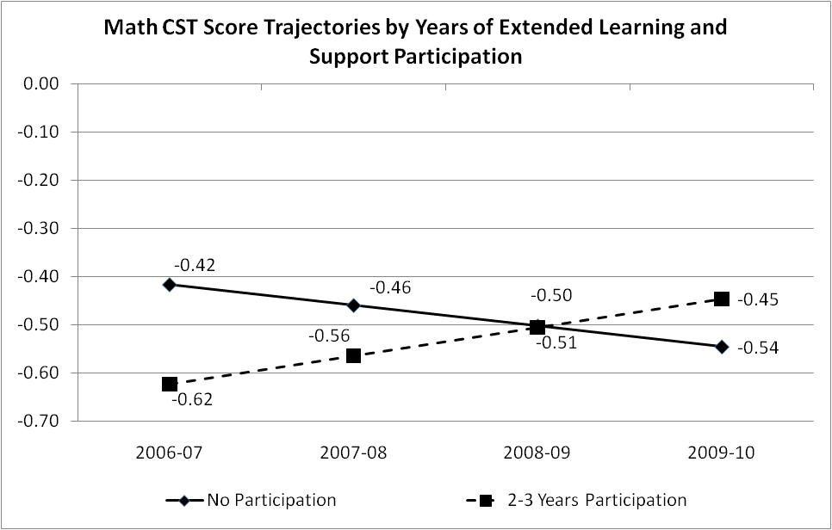
Support/Extended Learning Linked to Math Scores
Notes:
Looks at 2- or 3-year participants compared to those with no years of participation – left out one year
These findings are only long term – this was the first year we saw this pattern be significant.
No significant relationship with ELA scores

Slide 10
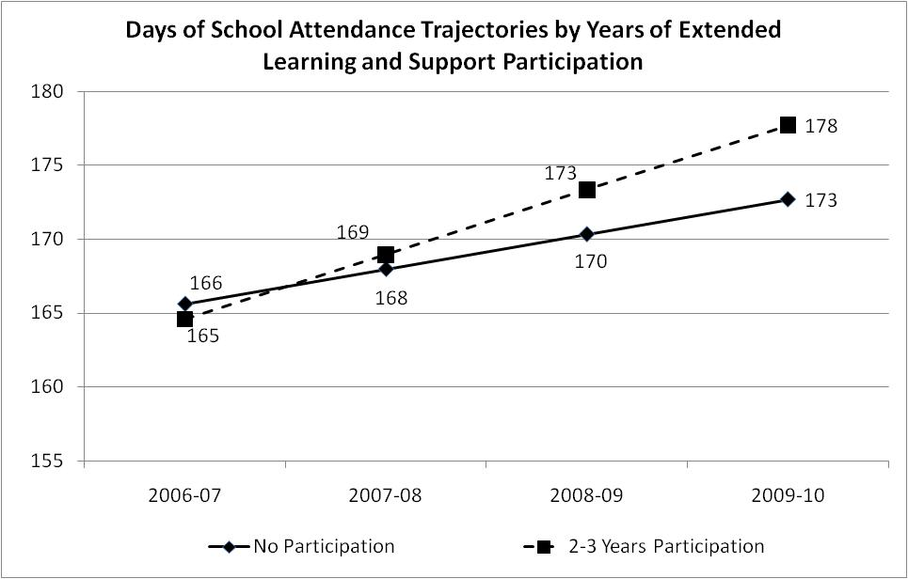
School Attendance and Support/Extended Learning
Notes:
Analysis only includes kids in 6,7, or 8 in 20009-10
Reference group is kids who go from 5th to 8th grade
1 year was also significantly higher than no years
This was the only program combination that had a significant effect

Slide 11
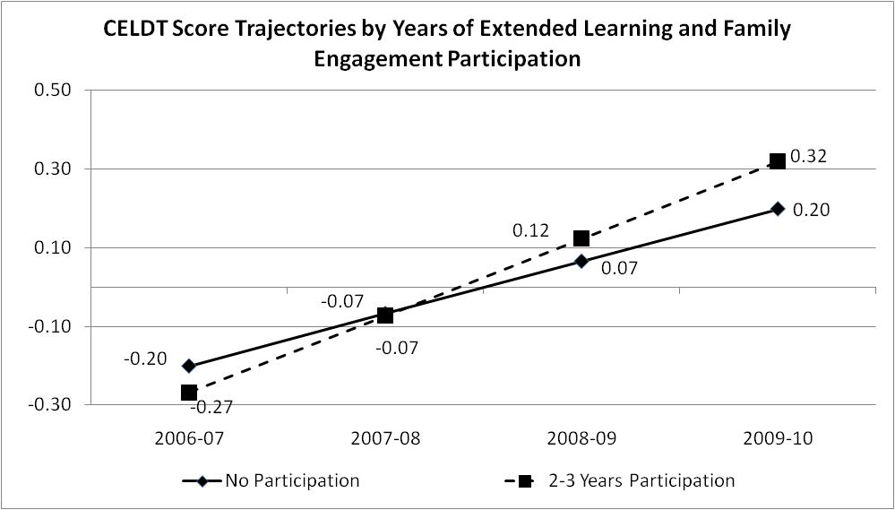
Family Engagement/Extended Learning Linked to CELDT Scores
Notes:
Note that these are kids who took the CELDT all three years
Significant growth specifically in the writing and speaking subtests

Slide 12
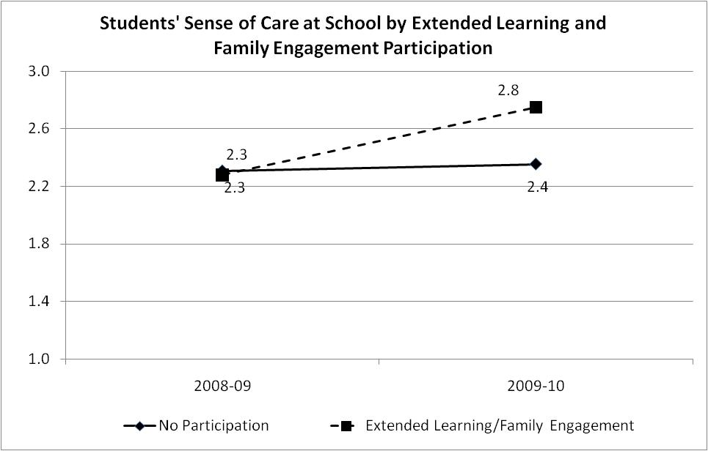
Sense of Care and Family Engagement/Extended Learning
Notes:
Talk about selection bias – kids with parents engaged may have been predisposed to higher senses of care
This was the only program combination that had a significant effect

Slide 13
Implications for the Community
Engaging practitioners in understanding data, using data to inform practice, and engaging in further inquiry at “data talks”
Building capacity to improve data collection and data sharing practices
Using findings to bolster support for community schools at the district level
Notes:
PQA and Cityspan
Feedback from Sandra that this was the first year that the evaluation reflected the work.
Sandra/coordinators gave feedback on how to structure program categories and how to interpret data that prevented lots of problems
As we developed new questions together and looked at data, the district saw that they needed to improve data collection. We were able to help advise on ways to do that, and they adopted a new data system to get better program participation data.

Slide 14
Implications for Future Research
Provides rigorous evidence on longitudinal effects of the multiple services community schools provide
Broaden data collection on more outcomes, such as health and social behaviors
Link quantitative outcome data to qualitative data on integration of services and practices that promote positive outcomes
Notes:
Bullet 1: adds to the current literature by looking at individuals, not whole school descriptives, while not flattening the community school model to one program
Give examples of second bullet – interactions among service provides and with staff, common planning time or meetings, referral mechanisms
Add stuff about how it informs the field

